Slide 1
Virtual Agent Integration
March 8, 2016

Slide 2
Contents
Virtual Agents
Purpose
How do virtual agents integrate with Chime?
  Three types of virtual agents
  Chime – virtual agent communication
Virtual agent source code
Demo: super simple virtual agents
Demo: MS Dynamics virtual agents

Slide 3
Virtual agents enhance agent efficiency.
Agents get MORE information FASTER
Seekers are deflected to self-help resources
Complimentary systems are updated automatically

Slide 4
How can we _________ ??
Integrate Chime with our external ticketing system?
Deflect common questions to the knowledge base/Wiki/FAQ?
Show the agent the seeker’s internal account data?
Show the agent the seeker’s personal device information?
Route the seeker to an agent that speaks their preferred language?
Send an e-mail transcript to an additional mailbox in a special format?
….

Slide 5
What is the purpose of a virtual agent?
Virtual Agents
Perform automated tasks at specific points in the Chime session lifecycle
Virtual Agent (v.a.) – a compiled C# assembly or C# file, that can have multiple classes, but at least one class must implement the IVirtualAgent interface of Chime’s ExtensionLibrary.dll.
We have a virtual agent development kit that includes:
  Necessary library
  Virtual agent templates, sample virtual agents
  Sandbox for testing during development

Slide 6
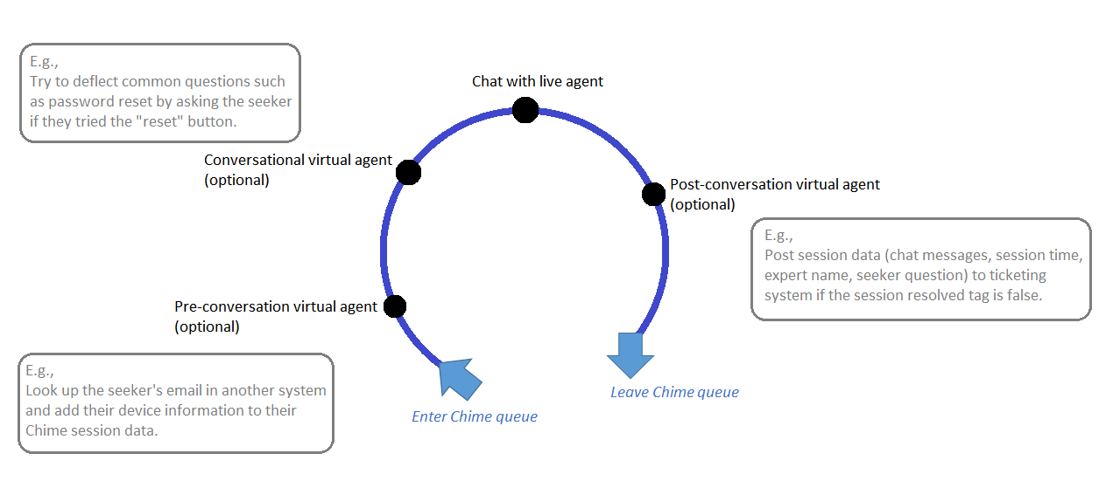
Three types of virtual agents per queue

Slide 7
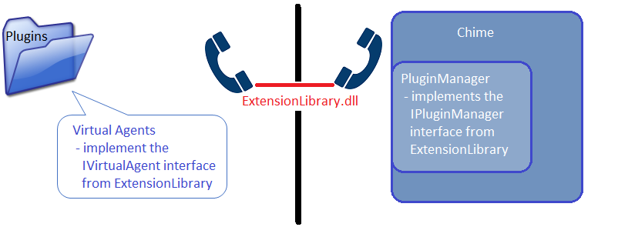
Chime – virtual agent communication
The Sandbox has tools to simulate the bridge of communication between Chime and the virtual agents
Both the virtual agents and the plugin manager within Chime have a reference to a common library, ExtensionLibrary.dll. This tool defines the methods by which they can communicate.

Slide 8
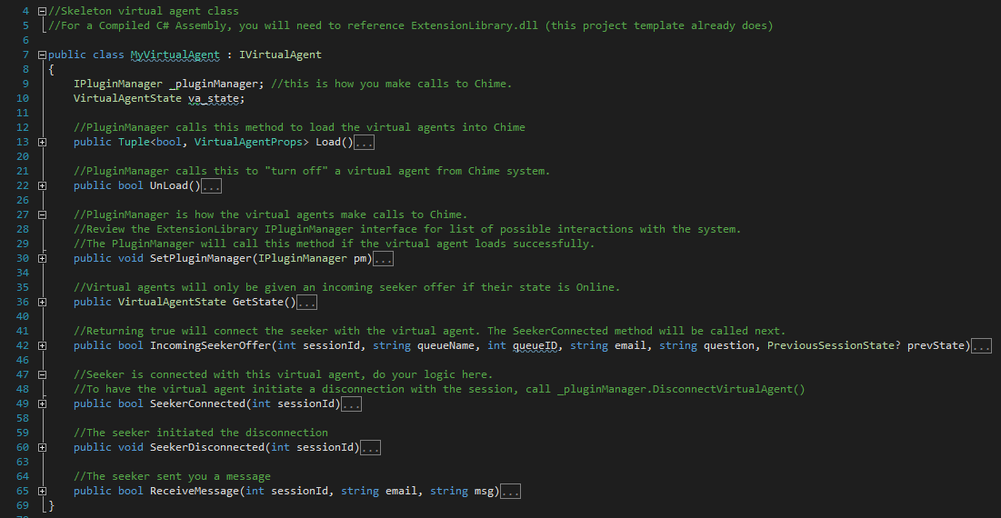
Virtual agent source code
8 methods to implement interface
For a simple v.a., most methods are 3 lines or less.
Bulk of logic is in the SeekerConnected method

Slide 9
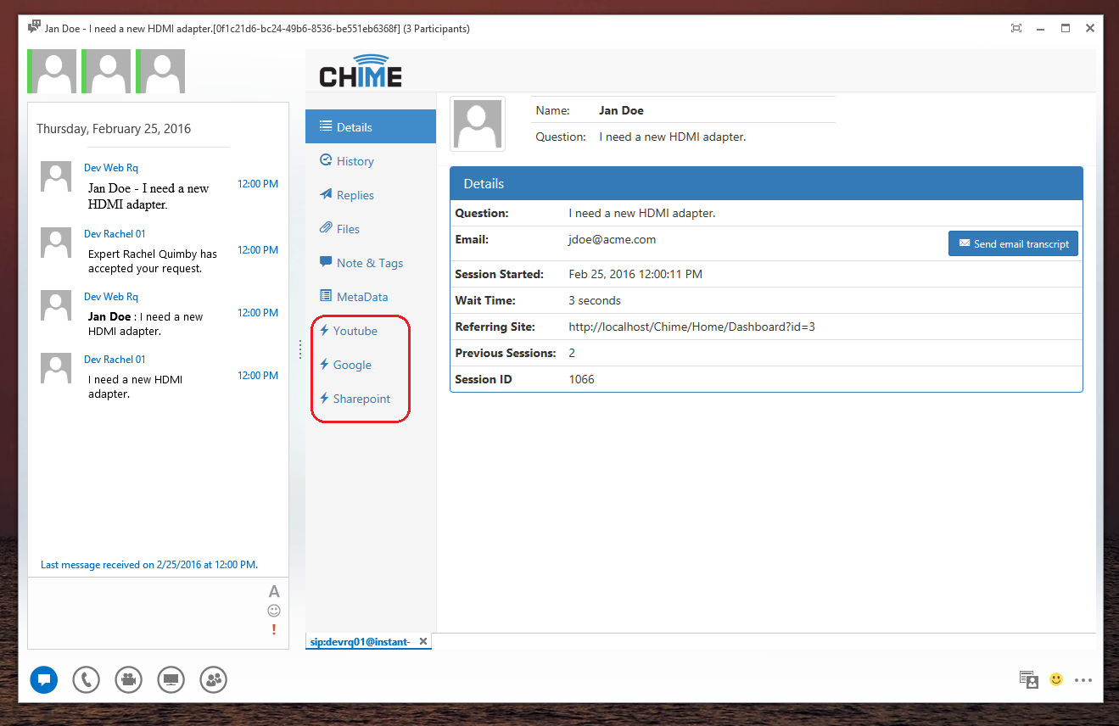
Super simple virtual agents
Virtual Agents
Demo

Slide 10
MS Dynamics virtual agents
Virtual Agents
Pre-conversation
  Creates a case
    Creates a contact if the e-mail isn’t found in the Contacts table
  Sends new tab with URL to the new case
Post-conversation
  Updates case description with session data (there’s a 2000 character limit to the description field)
Demo

Slide 11
Thank you
Visit addchime.com/virtual-agents.html for screen shots and more virtual agent integration videos!

